Slide 1



Shield Insurance Analysis
Trilochan Tripathy

Slide 2

About Company
Shield Insurance Company is a well-known provider of broad protection and trustworthy insurance, with an emphasis on customer satisfaction, covering customers from life's uncertainties.
About Project
As a data analyst, my tasks included working with our client, Shield Insurance, to understand their requirements, evaluating data, and creating a user-friendly smart dashboard.
The goal was to provide Shield Insurance with helpful business insights so that they could make more informed decisions.
Trilochan Tripathy

Slide 3
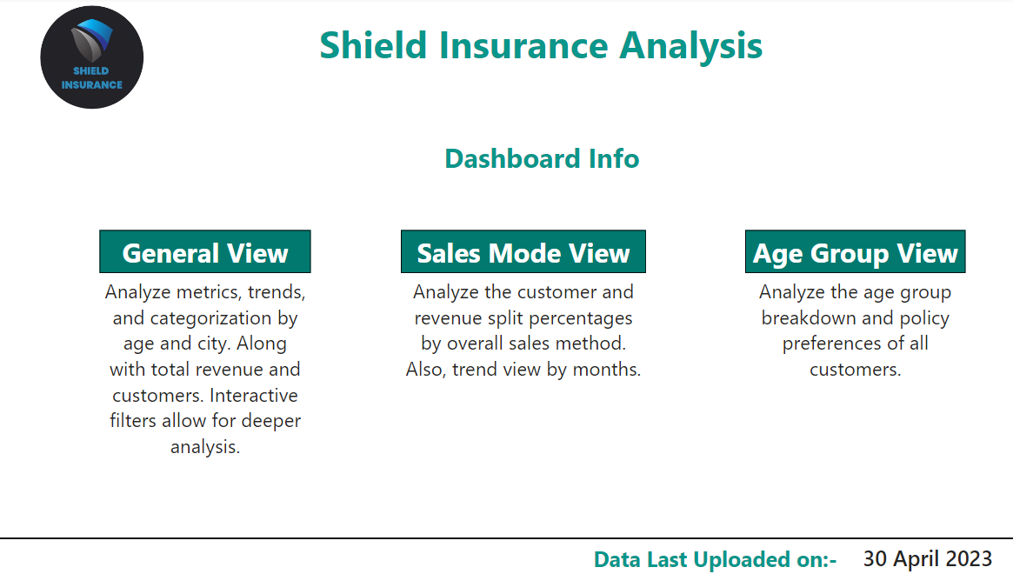
Home Page
Trilochan Tripathy

Slide 4
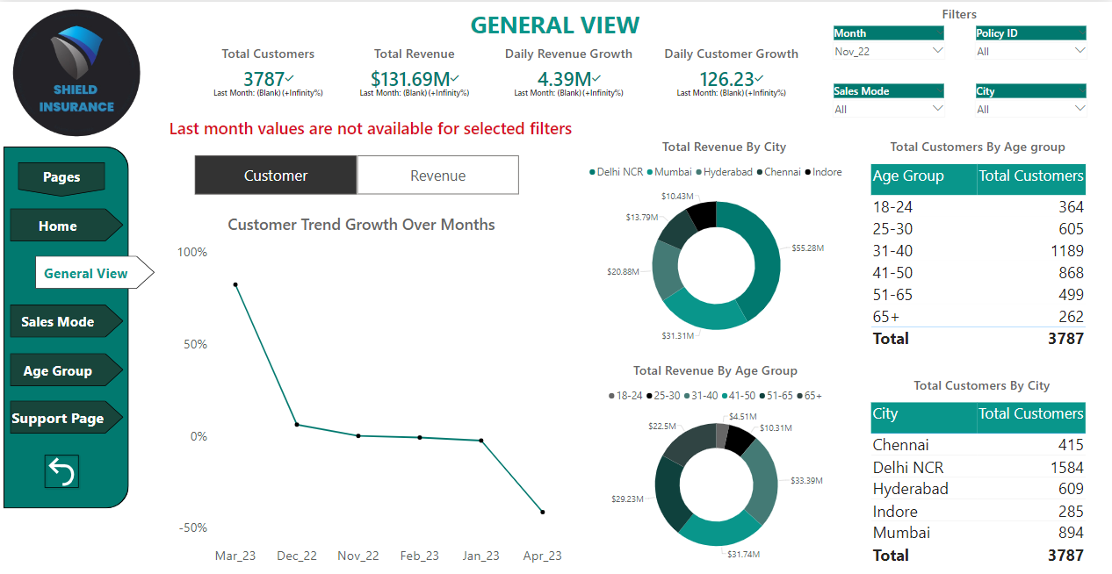
General View
Trilochan Tripathy

Slide 5
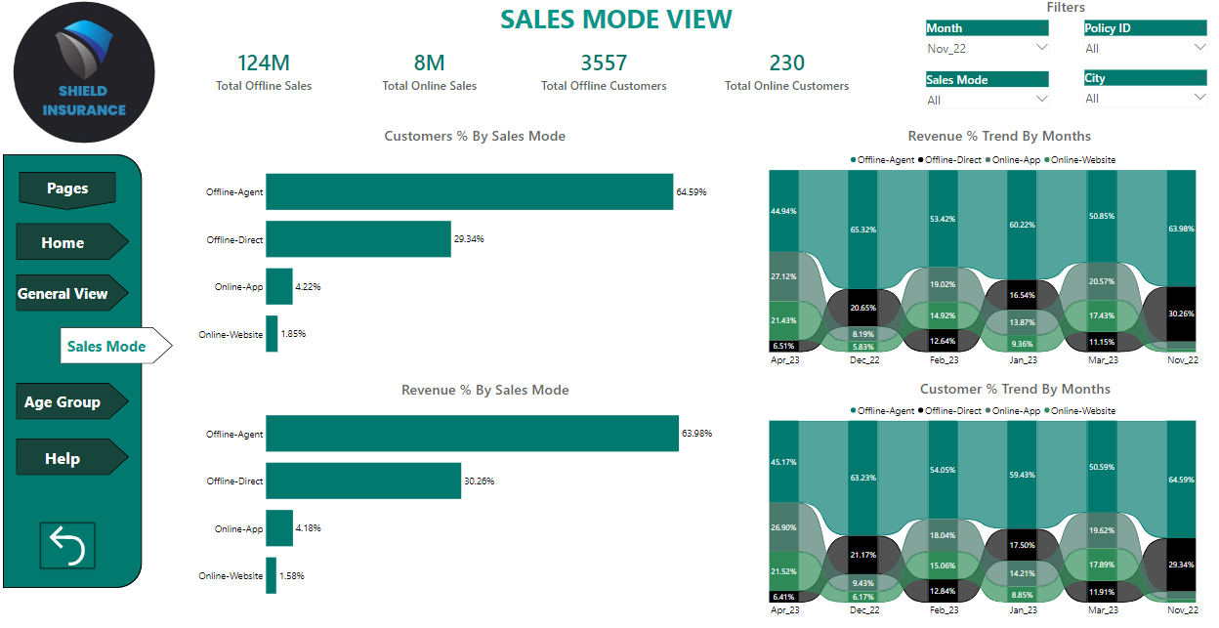
Sales Mode View
Trilochan Tripathy

Slide 6
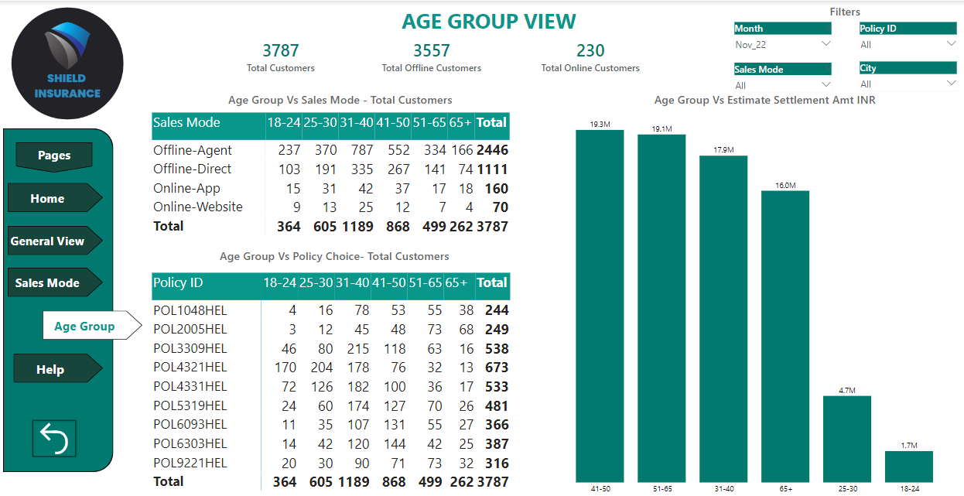
Age Group View
Trilochan Tripathy

Slide 7

Audio Presentation Link
https://youtu.be/iELvpUKzVUo?si=qNd5W7T_Zi30h7ys
Trilochan Tripathy

Slide 8

Trilochan Tripathy

